Slide 1

OBAYDULLAH KHAN ID: 201002093
Home Automation Using Arduino Uno
and Android App.
Presented by,
Khaled mahmud saoun Id:201002096
Dept. of Computer science & engineering ,
Green University of Bangladesh

Slide 2
Index
Introduction
Arduino Uno
Features of Arduino Uno
Bluetooth Module
Others Components
Procedure & Others

Slide 3
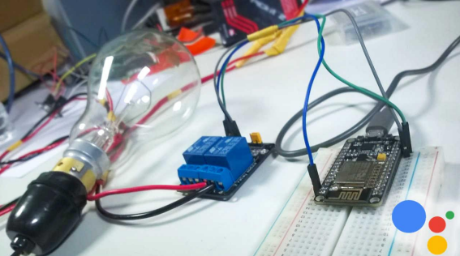
Introduction
Home Automation
Using
Arduino and Android App
Automation
simplicity
Internet of Things (IOT)

Slide 4
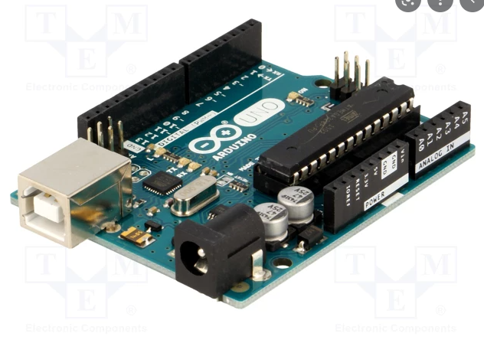
Arduino Uno
Microcontroller
With ATmega328p
Digital and analog I/O
USB powering System

Slide 5
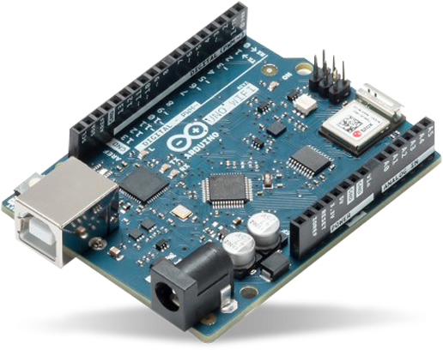
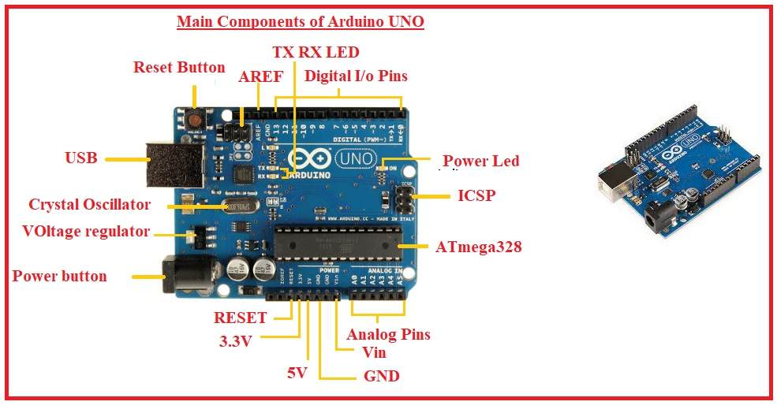
Features of Arduino Uno
Processor
Memory
External QSPI Flash
Wifi / Bluetooth Connectivity
Software support

Slide 6
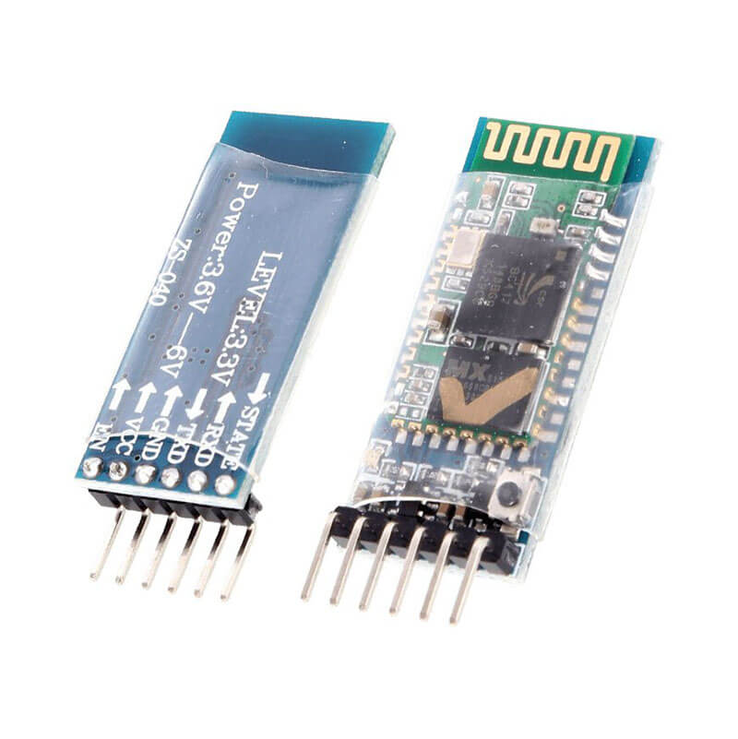
Bluetooth Module HC-05
Two way (Full Duplex Wireless connectivity
Smart Connectivity Indicator
Button for Mode
control

Slide 7
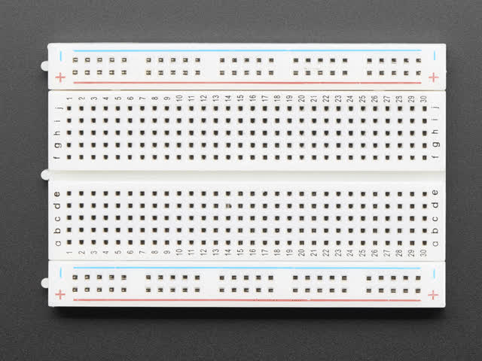
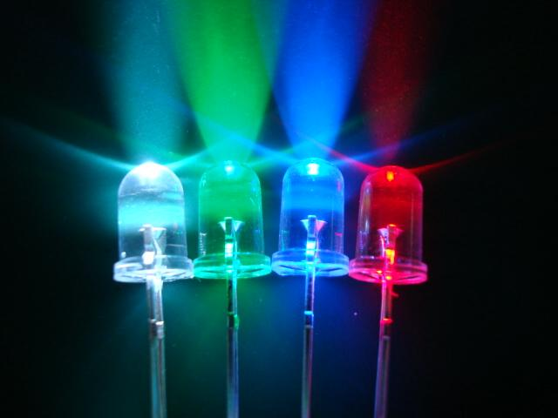
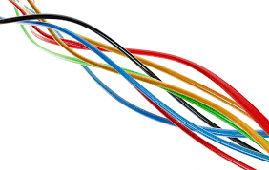
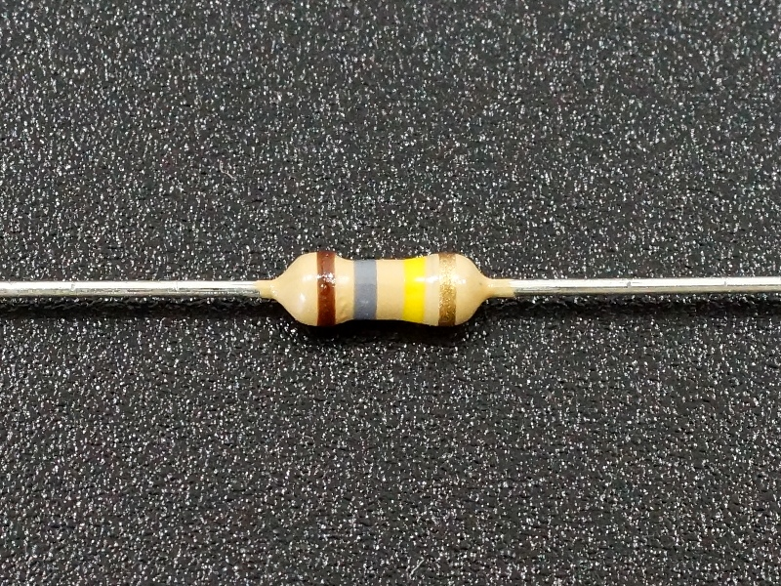
Others Components
BreadBoard
LED
Jumper & Resistor

Slide 8
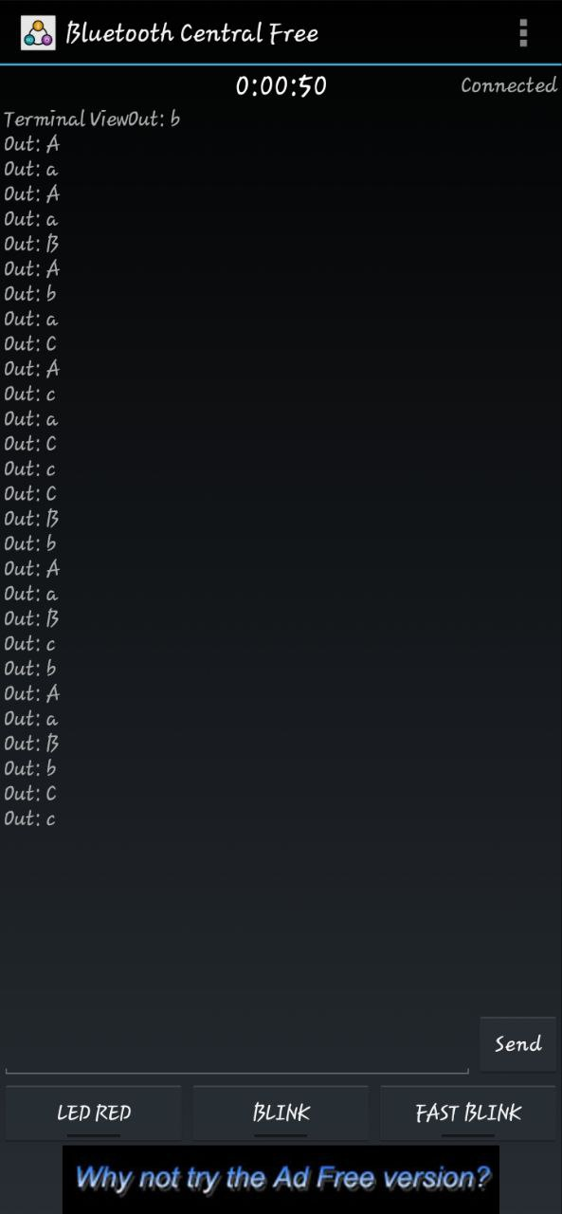
Android App For Controlling Home Automation

Slide 9
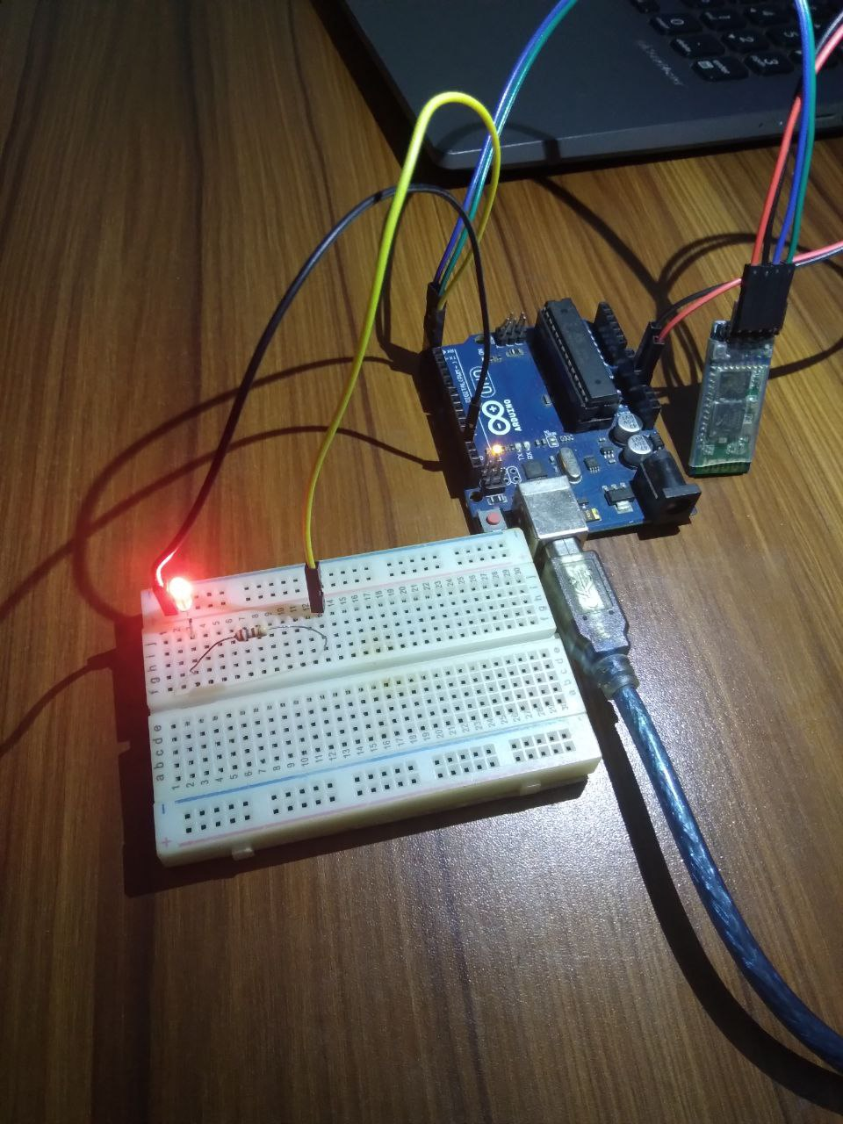
Procedure & Others
Connections
Work flow
discussion

Slide 10


